Slide 1
Pair trading for Currencies
Jason Tang (湯忠憲)
thtang@nlg.csie.ntu.edu.tw

Slide 2
Outline
Pairs formation
Trading strategy
Experiment results
Conclusion

Slide 3
Pair formation

Slide 4
Pairs selection
Computes the Engle-Granger cointegration test (1987)
Select training period
Testing Period: 2018/01/01 ~ 2019/07/30

Slide 5

Cointegration model
A group of nonstationary stock prices can have a common stochastic trend.
Two non-stationary time series $x(t)$ and $y\left(t\right)$ are cointegrated if some linear combination $ax\left(t\right)+by\left(t\right)$, with $a$ and $b$ being constants, is a stationary series.

Slide 6
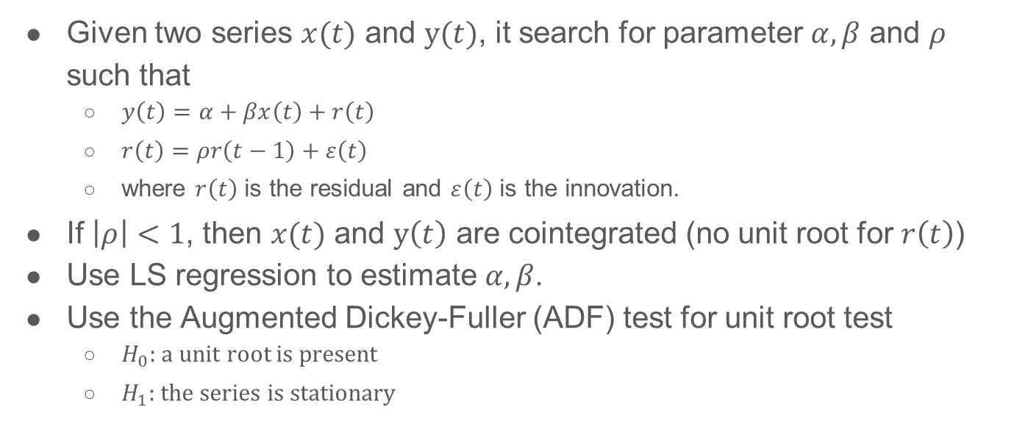
Engle-Granger cointegration test
Given two series $x(t)$ and $y(t)$, it search for parameter $α,β$ and $ρ$ such that
$y\left(t\right)=α+βx\left(t\right)+r\left(t\right)$
$r\left(t\right)=ρr\left(t−1\right)+ε\left(t\right)$
where $r\left(t\right)$ is the residual and $ε\left(t\right)$ is the innovation.
If $\left|ρ\right|<1$, then $x(t)$ and $y\left(t\right)$ are cointegrated (no unit root for $r\left(t\right)$)
Use LS regression to estimate $α,β$.
Use the Augmented Dickey-Fuller (ADF) test for unit root test
$H_{0}:$a unit root is present
$H_{1}:$the series is stationary
Engle, Robert F., and Clive WJ Granger. "Co-integration and error correction: representation, estimation, and testing."
Econometrica: journal of the Econometric Society (1987): 251-276.
Notes:
单整是处理伪回归问题的一种方式。如果一个时间序列经过一次差分变成平稳的，则称原序列是1阶单整的，记为I（1）。 一般地，如果时间序列经过d次差分后变成平稳序列，而经过d-1次差分仍不平稳，则称原序列是d阶单整序列，记为I（d）。
如果一个随机过程{xt}如果必须经过d次差分之后才能变成一个平稳的，可逆的ARMA过程，而当进行d-1次差分后仍是一个非平稳的过程，则称该过程具有d阶单整性。

Slide 7
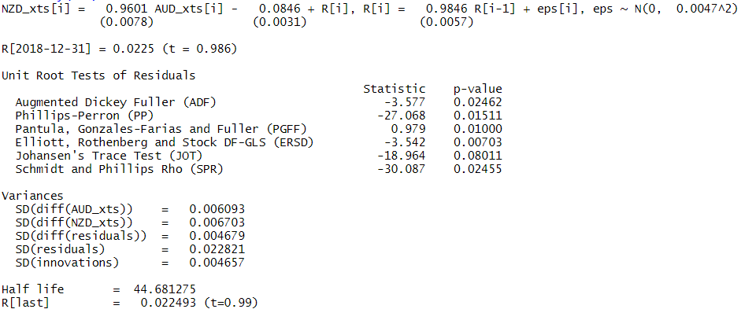
Testing result
Pair: AUD/USD and NZD/USD

Slide 8
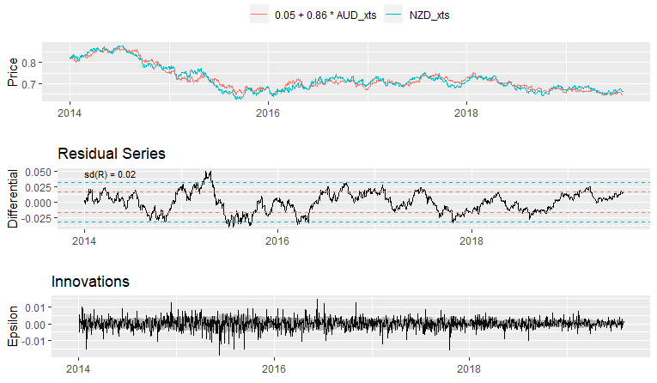
Plot testing result
No obvious trend

Slide 9
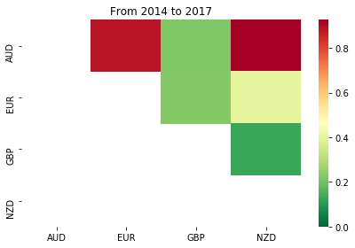
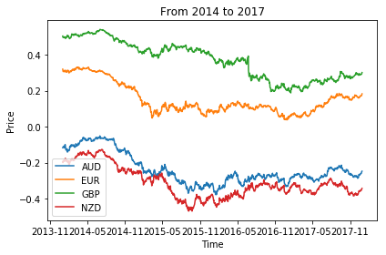
Selected pair and period

Slide 10
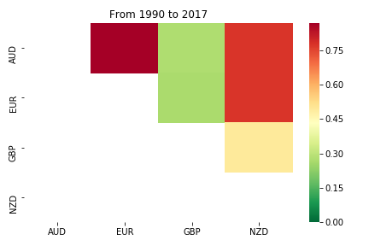
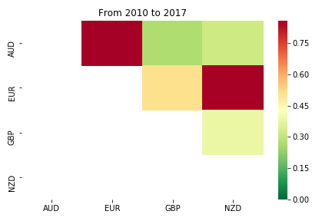
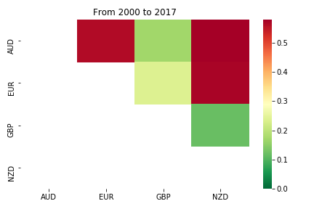
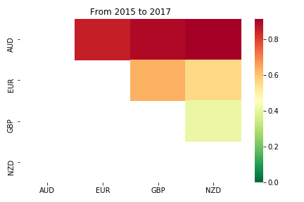
Other tading period

Slide 11
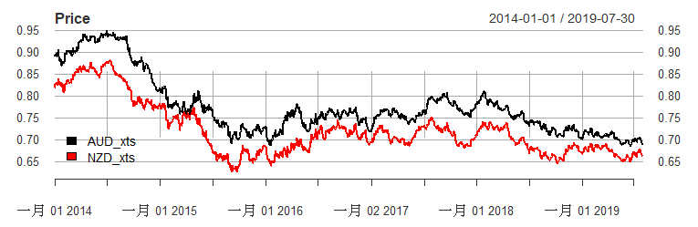
Prices of AUD and NZD against USD

Slide 12
Trading strategy

Slide 13
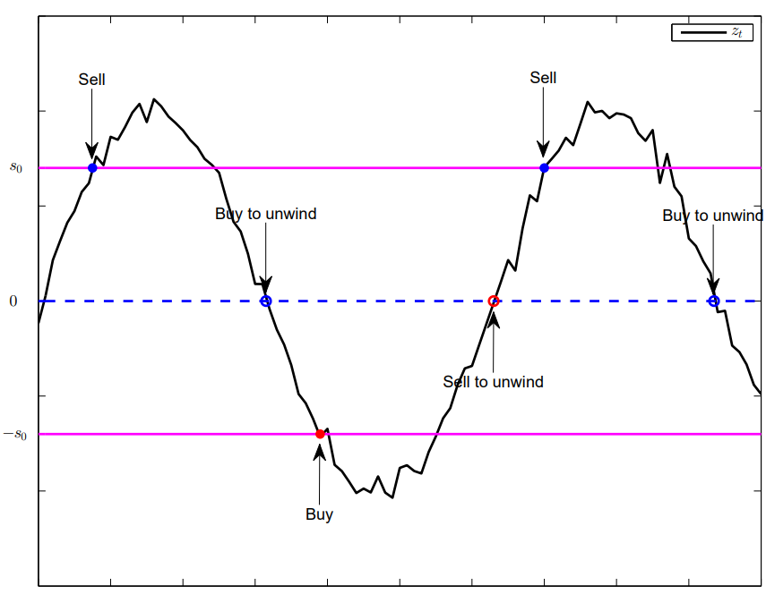

Trading strategy
Suppose the stationary spread $z_{t} = y_{1}(t)−γy_{2}(t)$has mean zero.
Statistical Arbitrage:
If spread is low $(z_{t}<−s_{0})$:
Buy the spread
Unwind the position when it reverts to
zero $i$ time steps $z_{t−1}=0$
If spread is high $(z_{t}>s_{0})$:
short-sell the spread
Unwind the position when it reverts to
zero $i$ time steps $z_{t−1}=0$
​Yiyong Feng and Daniel P. Palomar, A Signal Processing Perspective on Financial Engineering, Foundations and Trends® in Signal Processing, Now Publishers, 2016.

Slide 14
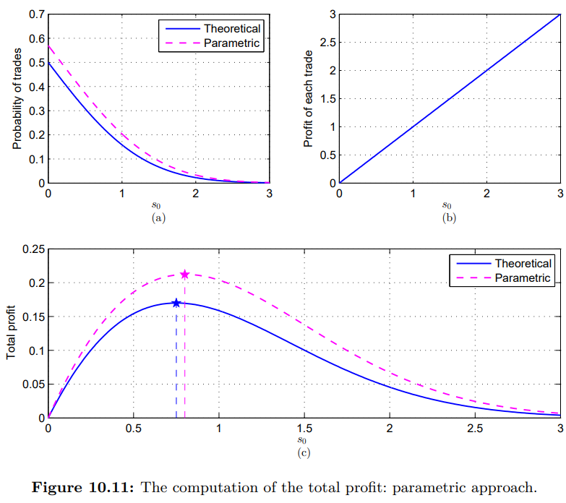

Optimum threshold $s_{0}$: Parametric approach
Fit the spread dynamic with a specific model
white Gaussian noise model
Set threshold $s_{0}$ = 0.75
​Yiyong Feng and Daniel P. Palomar, A Signal Processing Perspective on Financial Engineering, Foundations and Trends® in Signal Processing, Now Publishers, 2016.

Slide 15
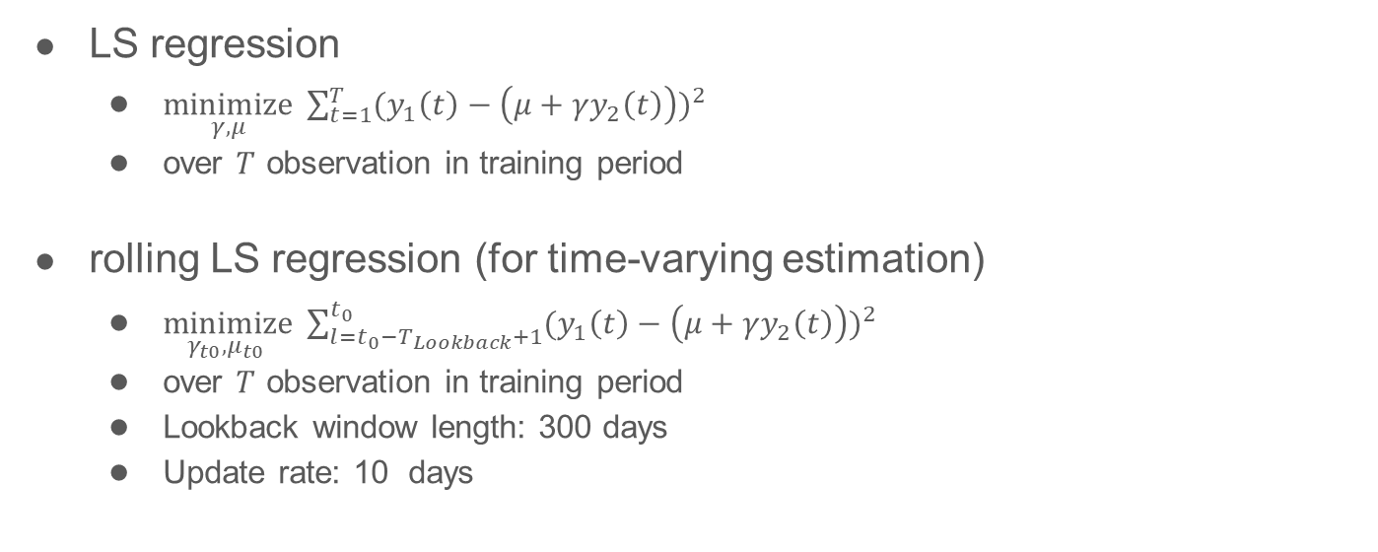
Methodology for estimating γ and μ
LS regression
$\underset{γ,μ}{minimize}{ \sum_{t=1}^{T}{{(y_{1}\left(t\right)−\left(μ+γy_{2}\left(t\right)\right))}^{2}}}$
over $T$ observation in training period
rolling LS regression (for time-varying estimation)
$\underset{γ_{t0},μ_{t0} }{minimize}{ \sum_{l=t_{0}−T_{Lookback}+1}^{t_{0}}{{(y_{1}\left(t\right)−\left(μ+γy_{2}\left(t\right)\right))}^{2}}}$
over $T$ observation in training period
Lookback window length: 300 days
Update rate: 10 days

Slide 16
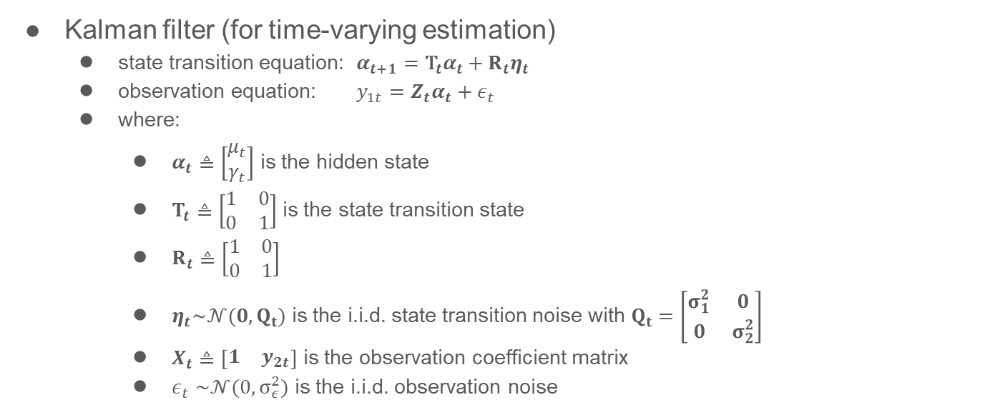
Methodology for estimating γ and μ (cont’d)
Kalman filter (for time-varying estimation)
state transition equation: $α_{t+1}={\text{T}}_{t}α_{t}+R_{t}η_{t}$
observation equation: $y_{1t}=Z_{t}α_{t}+ε_{t}$
where:
$α_{t}≜\left[\begin{matrix}μ_{t} \\ γ_{t}\end{matrix}\right]$ is the hidden state
$T_{t}≜\left[\begin{matrix}1 & 0 \\ 0 & 1\end{matrix}\right]$ is the state transition state
$R_{t}≜\left[\begin{matrix}1 & 0 \\ 0 & 1\end{matrix}\right]$
$η_{t}\sim 𝒩(0, Q_{t})$ is the i.i.d. state transition noise with $Q_{t}=\left[\begin{matrix}σ_{1}^{2} & 0 \\ 0 & σ_{2}^{2}\end{matrix}\right]$
$X_{t}≜\left[\begin{matrix}1 & y_{2t}\end{matrix}\right]$ is the observation coefficient matrix
$ε_{t}$ $\sim 𝒩(0,σ_{ε}^{2})$ is the i.i.d. observation noise

Slide 17
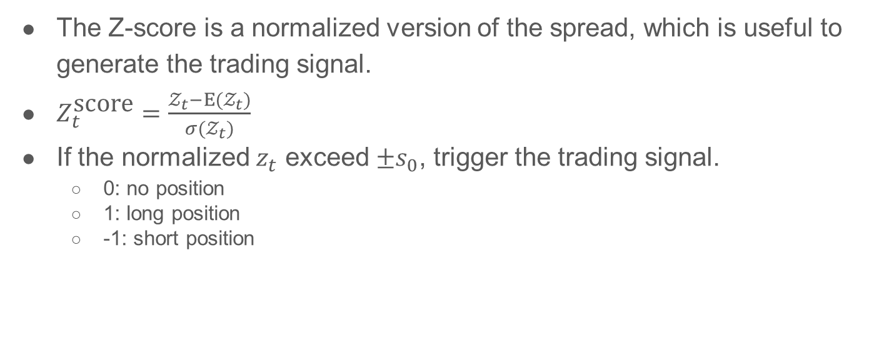
Z-normalization and Signal generating
The Z-score is a normalized version of the spread, which is useful to generate the trading signal.
$Z_{t}^{\text{score}}=\frac{𝒵_{t}−E(𝒵_{t})}{σ(𝒵_{t})}$
If the normalized $z_{t}$ exceed $±s_{0}$, trigger the trading signal.
0: no position
1: long position
-1: short position

Slide 18
Experiment results

Slide 19
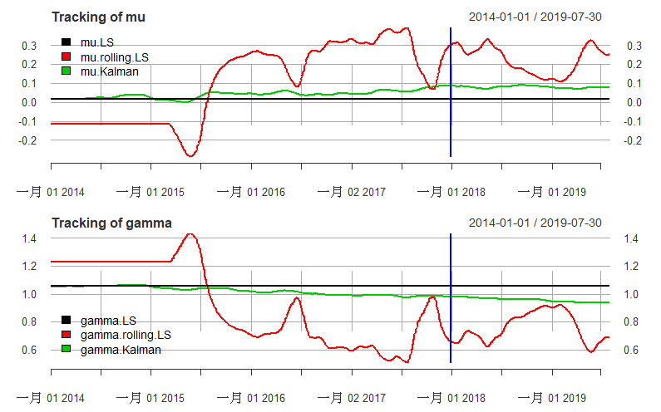
Parameter tracking

Slide 20
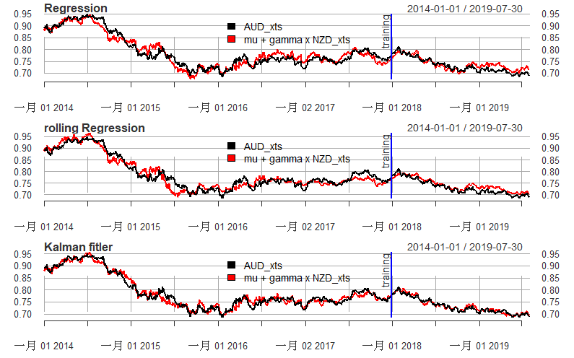
Regression using different estimation method

Slide 21
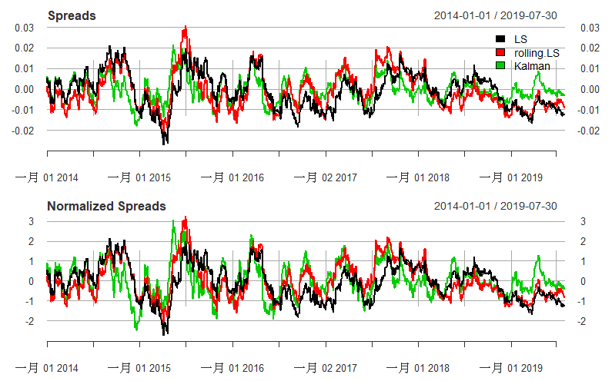
Spread

Slide 22
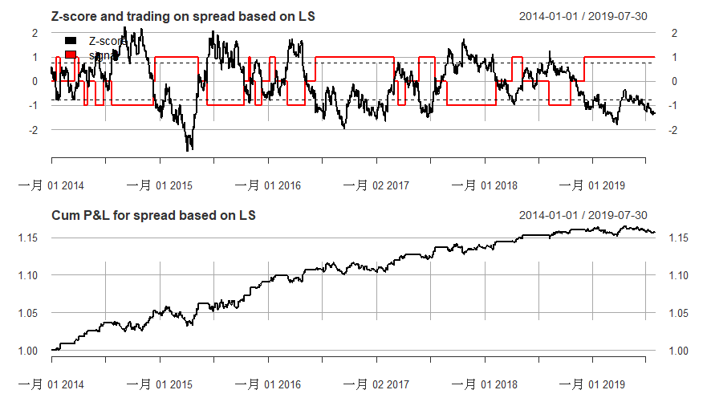
LS regression
spread seems to be drift from equilibrium

Slide 23
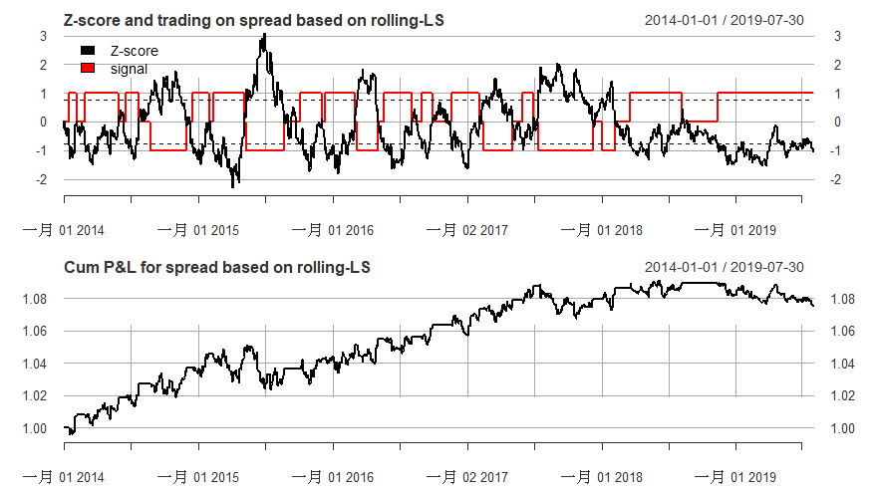
Rolling LS regression
spread blows up and incurs losses
spread seems to be drift from equilibrium

Slide 24
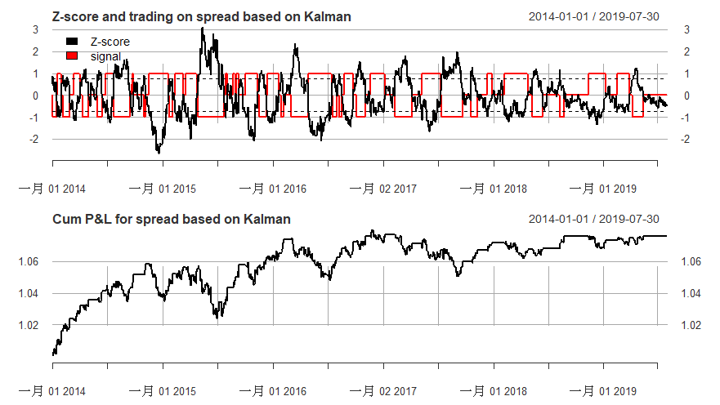
Kalman filter
Spread blows up and incurs losses

Slide 25
Performance measurement (on testing period)
 | LS | rolling-LS | Kalman
Volatility | 0.000961 | 0.001084 | 0.000743
StdDev Sharpe | 0.050247 | -0.01103 | 0.012807
VaR Sharpe | 0.034007 | -0.00707 | 0.008065
ES Sharpe | 0.022922 | -0.00524 | 0.004991
Holding period | 46.166667 | 62.6 | 15.58333
Cumulative return | 0.019687 | -0.00493 | 0.003921

Slide 26
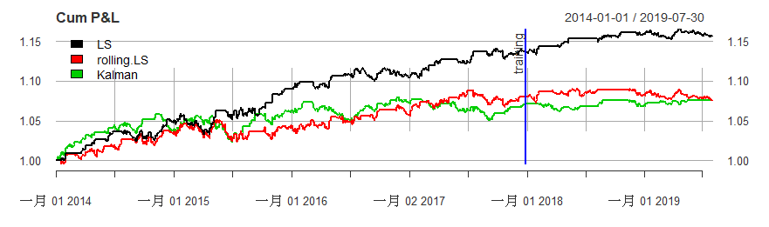
Cumulative P&L Curve
Compute the cumulative P&L.
The same initial budget of, say, 1$ is reinvested every time we enter a trade (even if the wealth at some point is 10$, still only 1$ is invested).

Slide 27

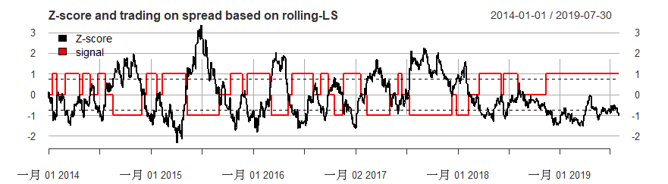
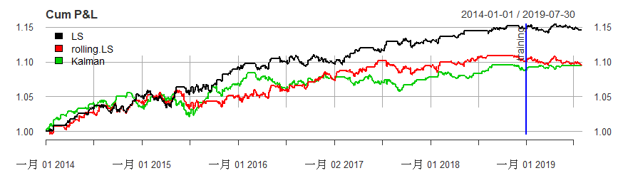
How about considering testing period more recently?
Set testing period: 2019/01/01 ~ 2019/07/30
Parameters shifted a little bit since the end of 2018.
LS and rolling-LS can not deal with time-varying parameters effectively.
spread seems to be drift from equilibrium for both LS and rolling-LS
 | LS | rolling-LS | Kalman
Volatility | 0.001022 | 0.001081 | 0.000611
StdDev Sharpe | -0.02029 | -0.04575 | 0.06648
VaR Sharpe | -0.01227 | -0.02611 | 0.059302
ES Sharpe | -0.00874 | -0.01897 | 0.059302
Holding period | Inf | Inf | 12.2
Cumulative return | -0.00331 | -0.00771 | 0.005907
Notes:
S2: traing ~2018, test 2019

Slide 28
Cumulative P&L Curve
spread seems to be drift from equilibrium

Slide 29
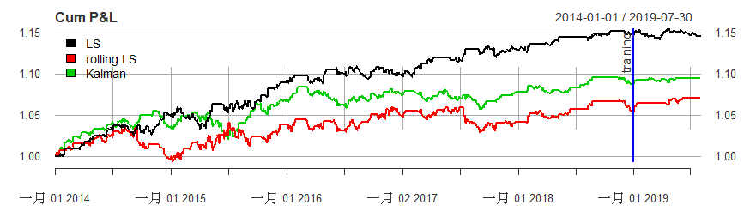
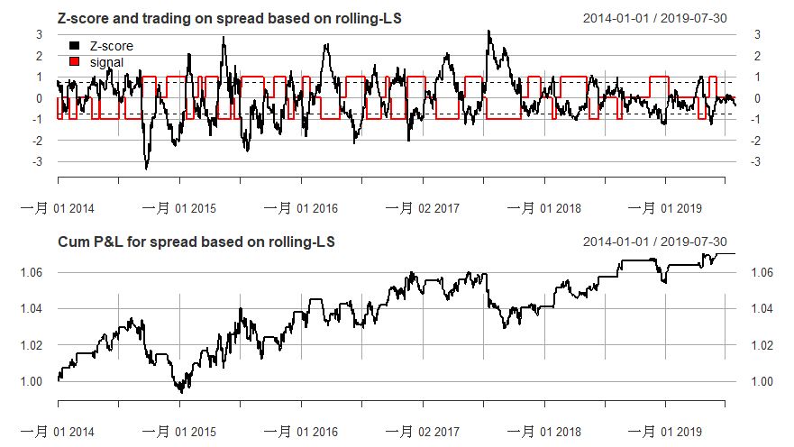
Make rolling-LS more sensitive
Set look back window size from 300 to 90 days for rolling-LS
Update rate: 10 days
Catch the parameter shifts!
But trigger more “spread exploding ”.
 | LS | rolling-LS | Kalman
Volatility | 0.001022 | 0.000806 | 0.000611
StdDev Sharpe | -0.02029 | 0.121372 | 0.06648
VaR Sharpe | -0.01227 | 1.302548 | 0.059302
ES Sharpe | -0.00874 | 0.029292 | 0.059302
Holding period | Inf | 7.6 | 12.2
Cumulative return | -0.00331 | 0.014262 | 0.005907
Notes:
Modify lookback window size for rolling-LS S3

Slide 30
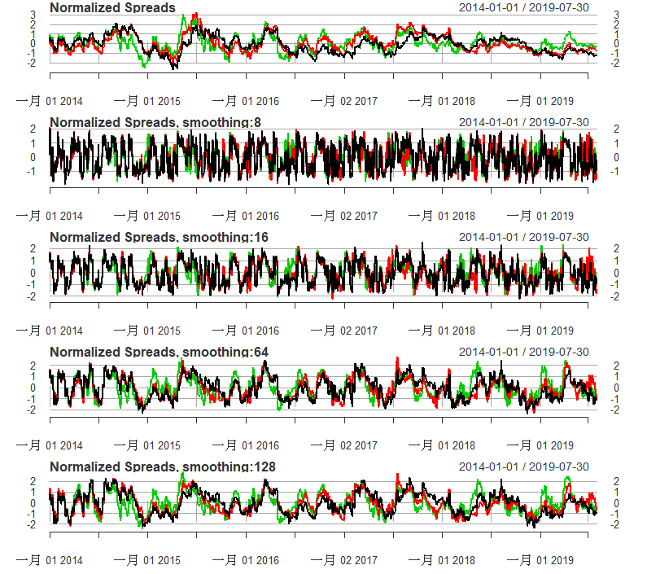
Different exponential smoothing window for spread
Here we can smooth the mean and variance for normalization to control the trading frequency.
The parameters are then time-varying.
Spread normalized by various smoothing window is visualized.

Slide 31
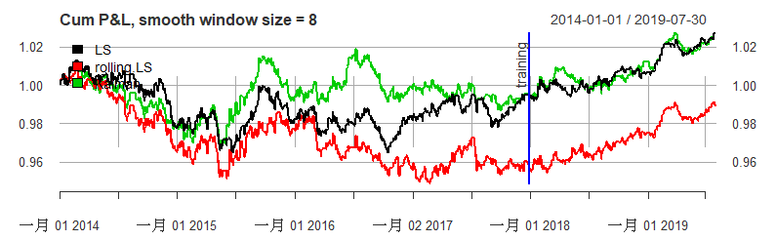
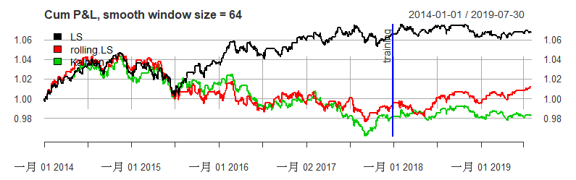
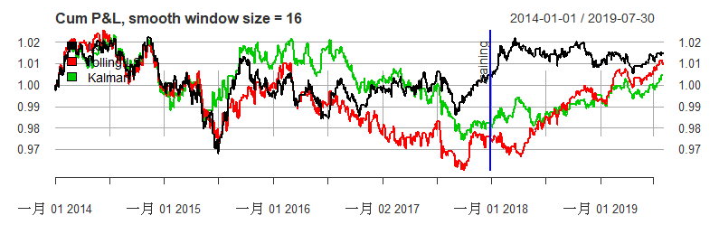
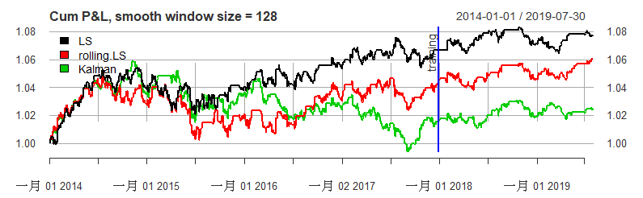
Cumulative P&L using various spread smoothing window

Slide 32
Conclusion

Slide 33
Conclusion
In our considered time period (2014-2019), the parameters do not change abruptly so that LS generates comparable results.
Cointegration can be detected in the given dataset, but its persistence is not clear and hard to find a proper period.
There is a trade off between tracking frequency (how often the parameters update) and stability of spreads.
high tracking frequency-> estimate the parameters locally-> easily cause spread exploding
low tracking frequency-> hard to handle parameter shift-> spread never revert
Parameters for normalized spread construction is sensitive to the trading performance.

Slide 34
Reference
Feng, Yiyong, and Daniel P. Palomar. "A signal processing perspective on financial engineering." Foundations and Trends® in Signal Processing 9.1–2 (2016): 1-231.
Gatev, Evan, William N. Goetzmann, and K. Geert Rouwenhorst. "Pairs trading: Performance of a relative-value arbitrage rule." The Review of Financial Studies 19.3 (2006): 797-827.
Chen, Cathy WS, Max Chen, and Shu-Yu Chen. "Pairs trading via three-regime threshold autoregressive GARCH models." Modeling Dependence in Econometrics. Springer, Cham, 2014. 127-140.
Engle, Robert F., and Clive WJ Granger. "Co-integration and error correction: representation, estimation, and testing." Econometrica: journal of the Econometric Society (1987): 251-276.
PPT from Prof. Daniel P. Palomar

